Slide 1
Teams Voice Training
Integrated Communications Platform
Created by ITSS Enterprise Collaboration Services
Fall, 2020

Slide 2
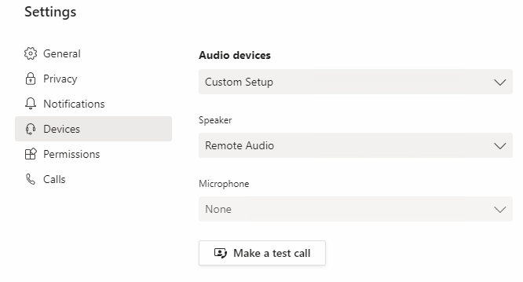
Starting Out
Set Up Your Devices
Specify Speaker
Watch for ‘Remote Audio,’ as this likely means you’re remoted into a different computer
We discourage making calls over a remote connection (VPN)
Set Microphone
Make a Test Call
Test functionality by using the Make a Test Call feature

Slide 3
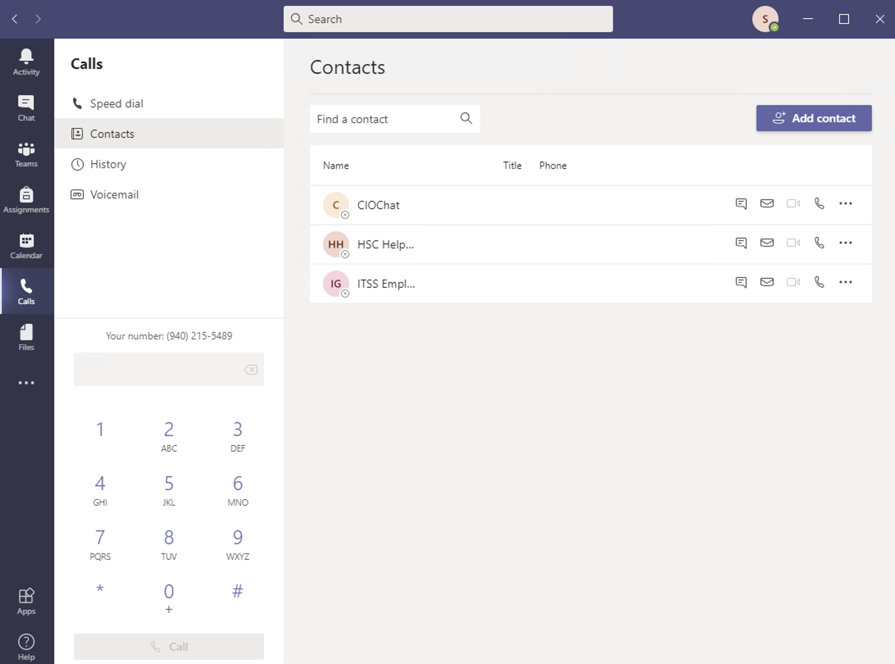
Calling Basics
Making Calls
Using the Dial Pad
If you do not see the dial pad, look for this button:
Using a Teams Contact
Add Contacts in Teams
Use the search bar to find contacts
Use the phone icon to call your contact

Slide 4
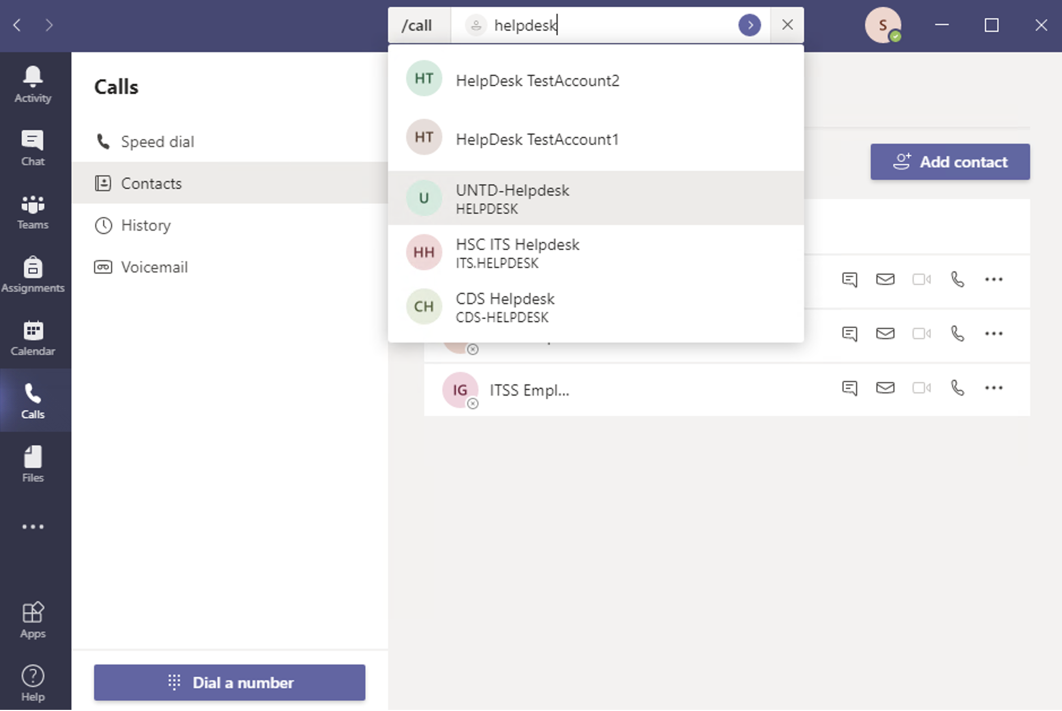
Calling Basics
Making and Receiving Calls
Keyboard Shortcut
Initiate the shortcut command by pressing:
on a PC or
on an Apple
A list of commands appears in the search field
Type ‘call’ and the name or number of person
Search results will automatically appear
Click on the recipient or press ‘enter’ to initiate the call

Slide 5
Receiving Calls
When someone calls you, this overlay will appear
Left button answers with video and audio on
Middle button answers with audio only
Right button declines the call

Slide 6
Demo

Slide 7
Questions about Making or Receiving Calls?

Slide 8
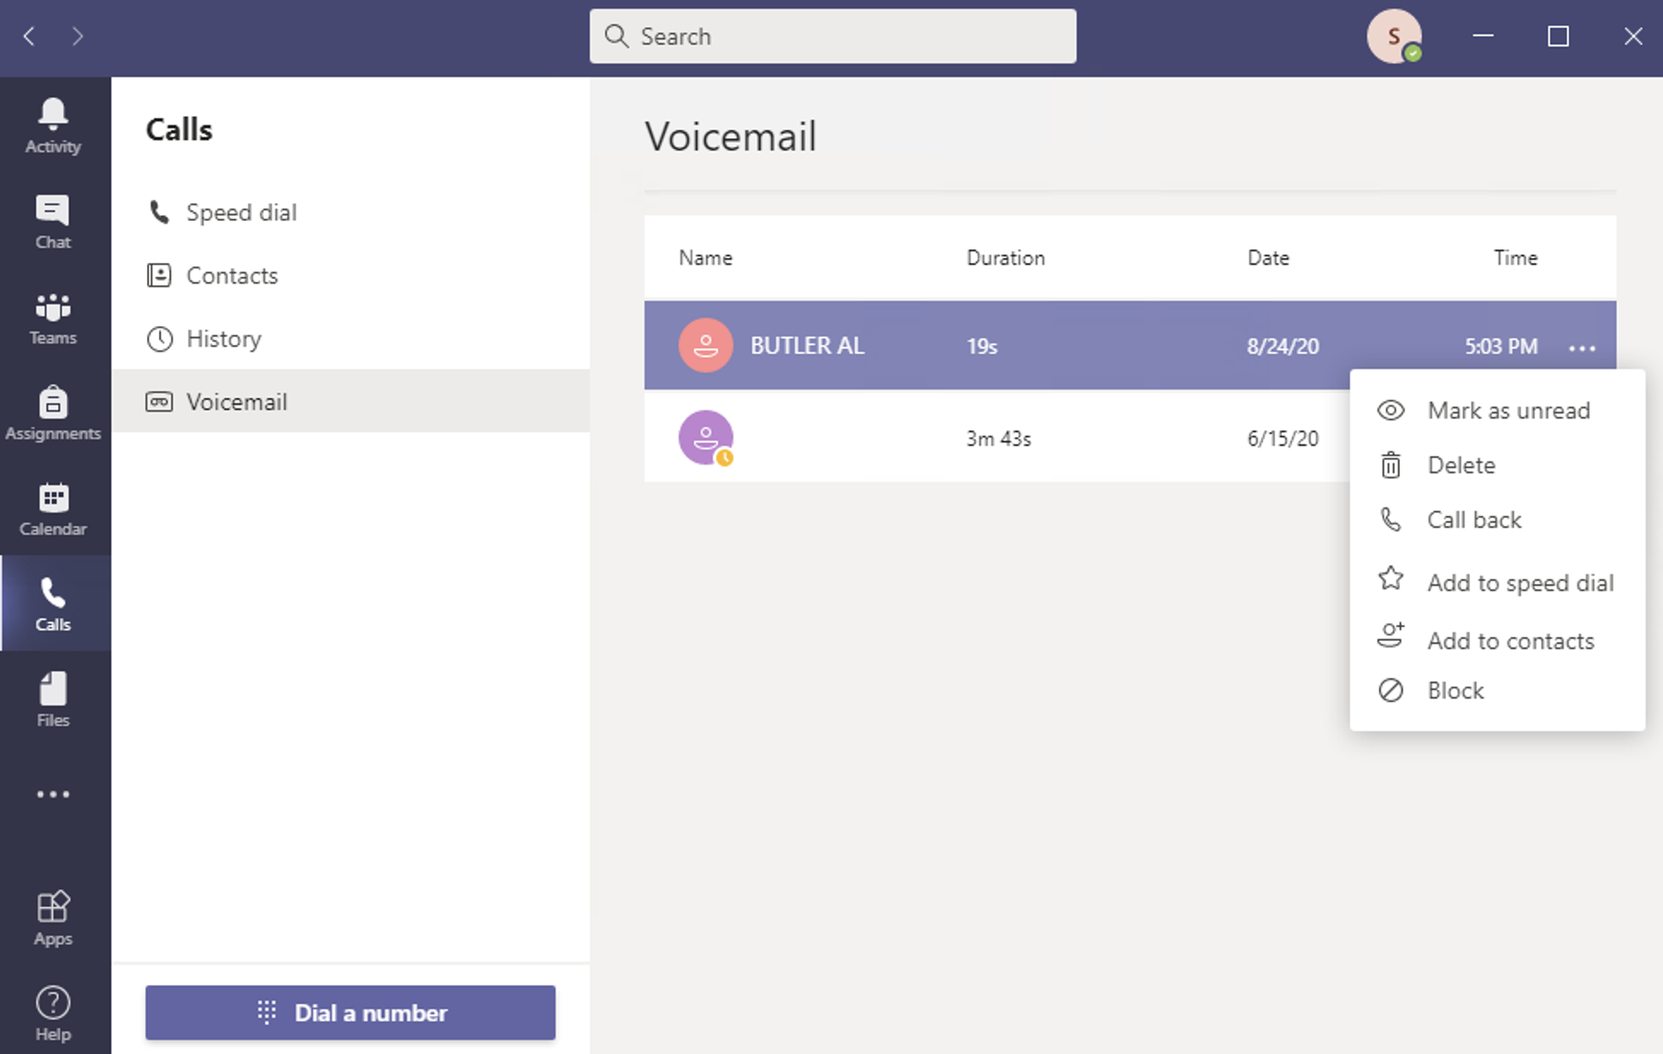
Checking Voicemail
See all new and saved voicemail messages at a glance
Select a voicemail message
Audio will play back on your selected device
Click on the … to the right of the message for more options

Slide 9
Voicemail Greeting
Navigate to Settings, Calls, and find the Configure Voicemail button:
Click the Record a greeting button
This will dial you into the voicemail system
Follow the prompts to configure your voicemail settings

Slide 10
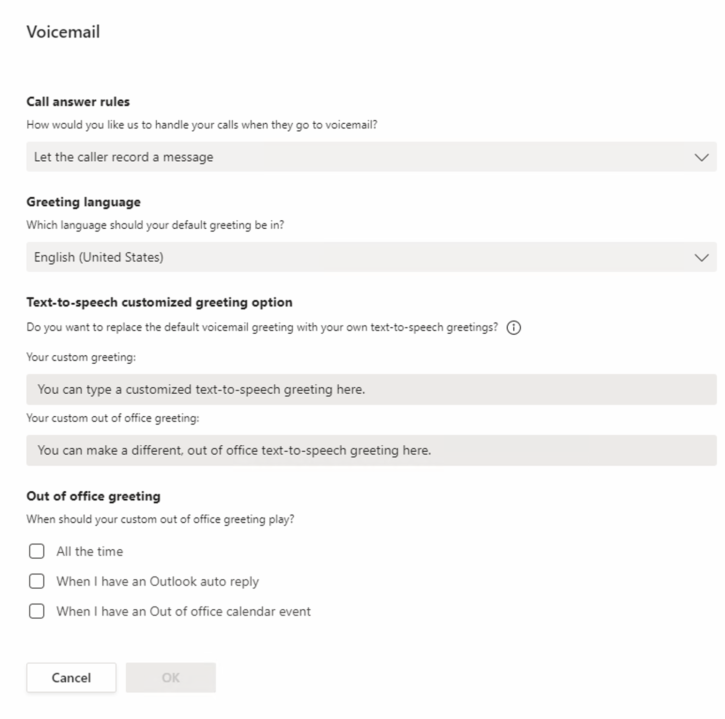
Voicemail Features
Out of Office
Use a custom Out of Office Greeting
Personalized recordings and text-to-speech options available for both standard and out of office voicemail greetings

Slide 11
Questions about Voicemail?

Slide 12
Calling Features
Transfer a Call
On an active call, click on the … and Transfer
Enter a person or a number to transfer the call
This immediately forwards the call
Consult then Transfer
Use the Consult then transfer option to introduce the caller, before forwarding the call

Slide 13
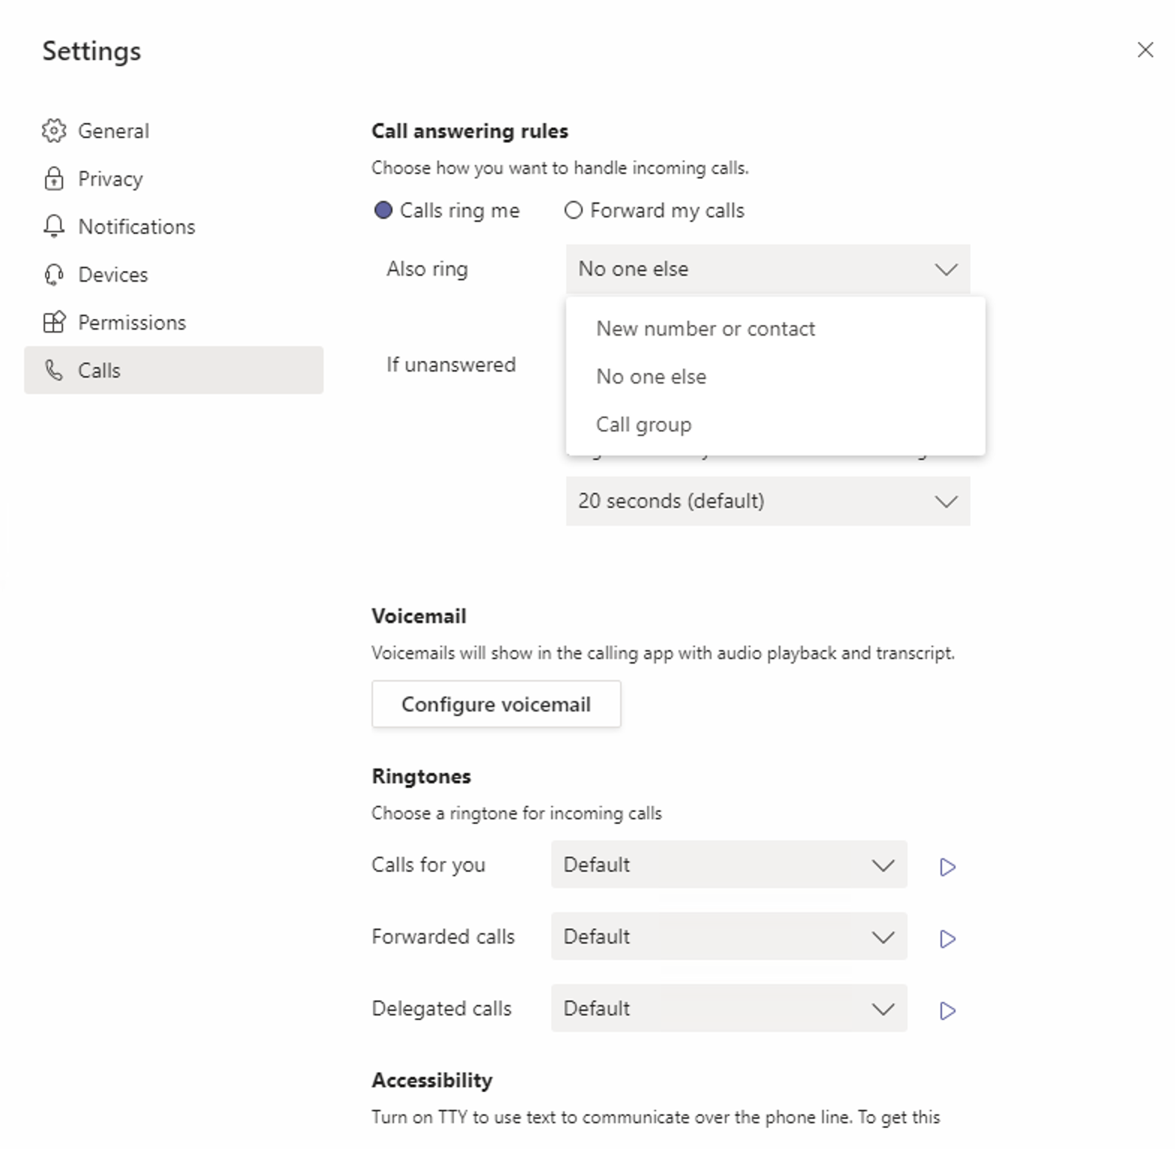
Calling Features
Simultaneous Ring
Calls will ring at multiple, designated destinations
Internal and external
Teams users or phone numbers
Calls are only answered by one recipient
Voicemail is delivered to the owner’s preference

Slide 14
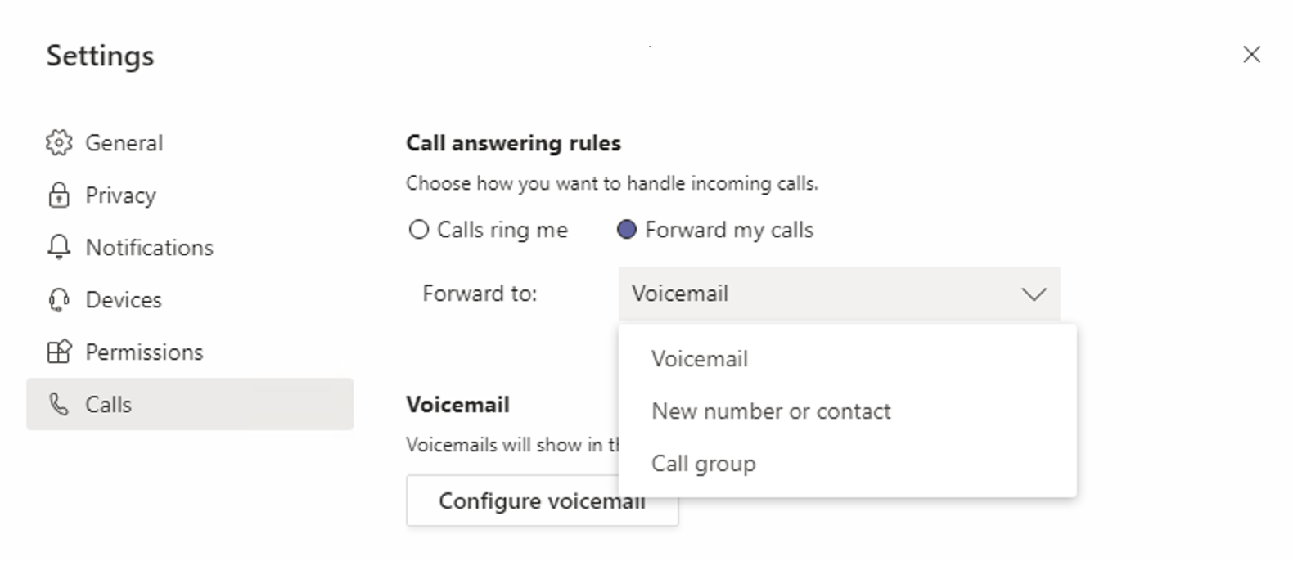
Calling Features
Forwarding
Forward calls to another Teams user, call group, or an internal or external phone number
Voicemail is recorded at the forwarded destination

Slide 15
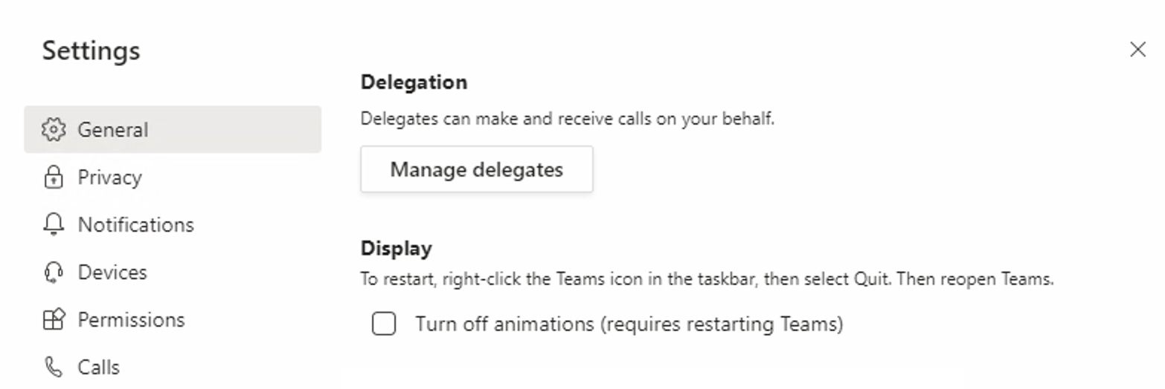
Calling Features
Delegation
Shares ownership with another Teams user
Make or receive calls as someone else
Voicemail is delivered to the owner’s preference

Slide 16
Questions about Calling Features?

Slide 17
Integrated Communications Platform
Unified communication across multiple Microsoft applications
Teams
Outlook
On the Web
Outlook Application
Office 365
Word
PowerPoint
Excel
Mobile Apps
Training Materials: https://icp.untsystem.edu/

Slide 18
Outlook
Initiate Teams Calls directly from Outlook
Status indicator shows if user is available
Expand contact card from within the email for communication choices
Use the phone option to start a call
Teams will automatically initiate the call

Slide 19
Start Chat from Outlook on the Web
Initiate Teams chat directly from Outlook on the Web
Open contact card
Expand contact details
Use the chat option to open a new chat with that user in Teams
Phone call can be initiated from the Teams chat window

Slide 20
Start Chat from Shared Office Documents
Initiate Teams chat directly from Office Applications
Open contact card
Use the chat option to open a new chat with that user in Teams
Phone call can be initiated from the Teams chat window

Slide 21
Questions about anything covered today?

